Slide 1
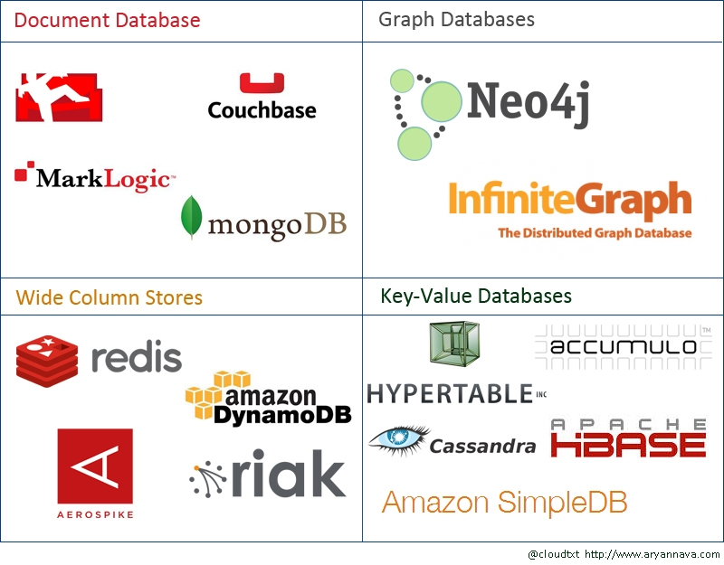
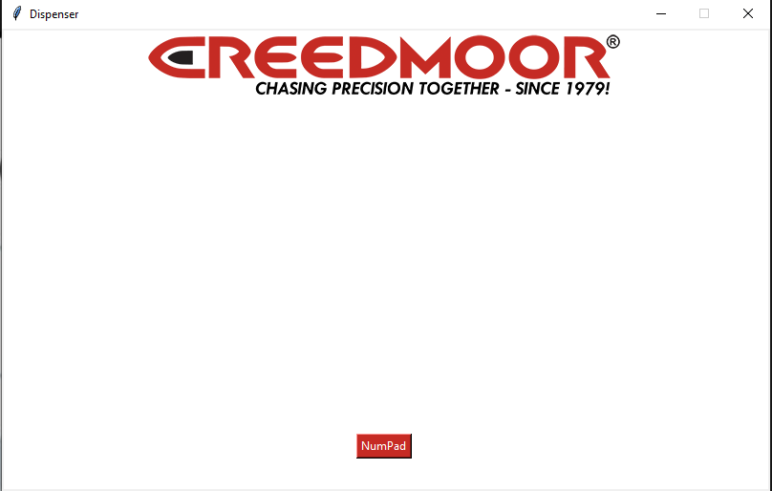
Week 2 (13-Jan to 18-Jan)

Slide 2
Week 2 (13-Jan to 18-Jan) Austin Stecklein
Goal/Task | % Done | Hours (Act.)
Backend (event handling and threading) | 50 | 8
I/O list for circuit schematic | 100 | 1
Drivers for steppers and accleometer | 10 | 4
Hours on task during the week (On track ≥ (13) / wk) | 13
Total hours on task so far this semester (On track ≥ 26 hrs) | 26

Slide 3
Progress made during the week (Log) (What I did)
Created event handler and successfully test running events from a pop GUI
Create I/O list for use in schematic
MicroSD card on order

Slide 4
Difficulties encountered during the week (What I did not do and why)
No SD card was found in package

Slide 5
Goals for this coming week (Ones that move the project forward the most)
Goal/Task | Stop Date (Est.) | Hours (Est.)
Finish event handler by allowing data to pass from the thread back to the GUI | 1/26 | 6
Get Code onto the beagle board | 1/26 | 2
Get stepper motor driver working | 1/26 | 6
Estimated time needed to work on goals for this coming week (typ. 13 hrs) | 14

Slide 6
How can we help you achieve your goals?

Slide 7
Week 2 (12-Jan to 18-Jan) Dale Andreoli
Goal/Task | % Done | Hours (Act.)
Everyone Complete Leadership Foundation: Clarify Purpose (p. 32-33), Team Purpose Statement (p. 34), Voice Finder (p. 64-67), Your Contribution Statement (p. 68), Win-Win Performance Agreement (p. 76) | 0 | 0
Research database options – Amazon Dynamo DB | 100 | 3
Assist with GUI – Research tkinter Python library, create mockup | 10 | 1
Project Objective / Mission Statements
Power Scale Dispenser:
Design, build, and test the electronics for the dispenser with a touch screen display and controlling two stepper motors by April 6, 2021 with a prototyping budget of $XXX USD and for less than 600 people-hours.
Hours on task during the week | 4
Total hours on task so far this semester | 17

Slide 8
Progress made during the week (Log) (What I did)
Collaborated with Austin on our needs for backend software
Researched NoSQL database options
Amazon Dynamo DB should fit our needs

Slide 9
Difficulties encountered during the week (What I did not do and why)
No problems yet

Slide 10
Goals for this coming week (Ones that move the project forward the most)
Goal/Task | Stop Date (Est.) | Hours (Est.)
Work with Jonathon to design GUI | 1/23/21 | 3
Implement GUI features | 1/24/21 | 6
Collaborate with Austin to determine what drivers will need to be written | 1/23/21 | 2
Estimated time needed to work on goals for this coming week | 11

Slide 11
How can we help you achieve your goals?
GUI thoughts and ideas

Slide 12
Week 2 (13-Jan to 18-Jan) John Stinger
Goal/Task | % Done | Hours (Act.)
Decide on a specific development board for the project. | 100% | 3
Meet with team to discus the scope and define roles | 100% | 2
Hours on task during the week (On track ≥ (13) / wk) | 10
Total hours on task so far this semester (On track ≥ 26 hrs) | 22

Slide 13
Progress made during the week (Log) (What I did)
For example: Resources found (links, manuals), Designs created, Decisions made and corresponding rational, Photos of prototype progress, etc.
Inspected the material received
Decided to continue using the provided Beagle Board for development
Defined the scope better and the individual roles and goals

Slide 14
Difficulties encountered during the week (What I did not do and why)
None

Slide 15
Goals for this coming week (Ones that move the project forward the most)
Goal/Task | Stop Date (Est.) | Hours (Est.)
Check viability of current accelerometer |  | 2
Start the drafting of the circuit board |  | 10 +
Estimated time needed to work on goals for this coming week (typ. 13 hrs) | 12 +

Slide 16
How can we help you achieve your goals?
Continued direction
Advice on circuit building software
Did we want any kind of wireless capabilitie?
Can the power supply be its own board?

Slide 17
Week 2 (13-Jan to 18-Jan) Jonathan Phillips
Goal/Task | % Done | Hours (Act.)
Reviewed the Hardware sent from Creedmoor | 100 | 1.5
Ordered the LCD Screen (Arriving Today) | 100 | 0.5
Worked on the front end | TBD | 5
Hours on task during the week (On track ≥ (13) / wk)
Total hours on task so far this semester (On track ≥ 26 hrs)

Slide 18
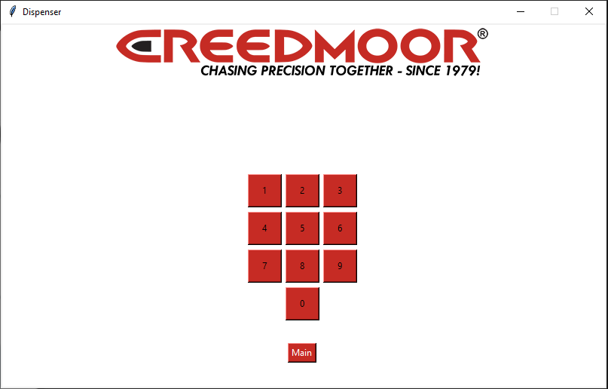
Progress made during the week (Log) (What I did)
For example: Resources found (links, manuals), Designs created, Decisions made and corresponding rational, Photos of prototype progress, etc.

Slide 19
Difficulties encountered during the week (What I did not do and why)
Understanding Python

Slide 20
Goals for this coming week (Ones that move the project forward the most)
Goal/Task | Stop Date (Est.) | Hours (Est.)
UML Diagram for the frontend | 1/25/22 | 1.5
Continue working on the frontend | Ongoing | 11.5
Estimated time needed to work on goals for this coming week (typ. 13 hrs) | 13

Slide 21
How can we help you achieve your goals?
Do you have an idea of what you would like the layout of the display to be?

